Slide 1
Pathnames, Pipe, tee command and Compressing and Archiving File

Slide 2
Absolute Pathnames
A path is a unique location to a file or a folder in a file system of an OS.A path to a file is a combination of / and alpha-numeric characters.
Absolute Path-name
An absolute path is defined as the specifying the location of a file or directory from the root directory(/). To write an absolute path-name:
Start at the root directory ( / ) and work down.
Write a slash ( / ) after every directory name (last one is optional)

Slide 3
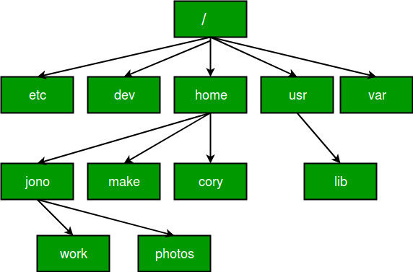
Relative path
Relative path is defined as the path related to the present working directly(pwd). It starts at your current directory and never starts with a / .
To be more specific let’s take a look on the below figure in which if we are looking for photos then absolute path for it will be provided as /home/jono/photos but assuming that we are already present in jono directory then the relative path for the same can be written as simple photos.

Slide 4
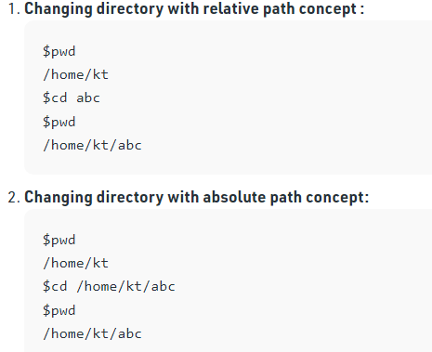
Example of Absolute and Relative Path
Suppose you are currently located in home/kt and you want to change your directory to home/kt/abc. Let’s see both the absolute and relative path concepts to do this:

Slide 5
Pipe
In Linux, the pipe command lets you sends the output of one command to another. Piping, as the term suggests, can redirect the standard output, input, or error of one process to another for further processing.
i.e data flows from left to right through the pipeline.
Syntax :
command_1 | command_2 | command_3 | .... | command_N

Slide 6
Pipes
Connecting standard input and output
Denoted by the “|” character

Slide 7
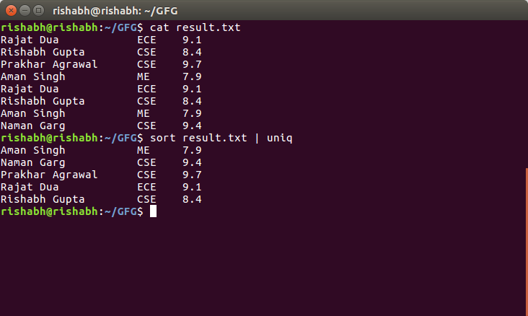
Example : 1. Listing all files and directories and give it as input to more command.
$ sort record.txt | uniq
Output :

Slide 8
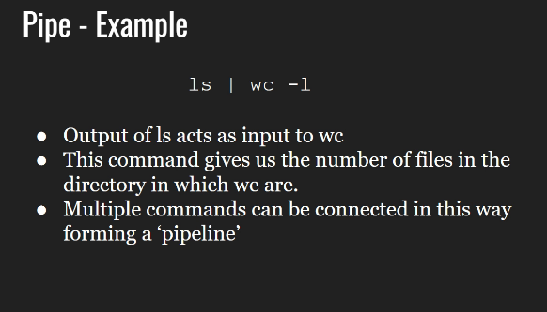
Pipe-Example
ls | wc –l
out

Slide 9
tee
An external command which is not a feature of the shell
Handles character stream by duplicating its input
It saves one copy in a file and writes the other to standard output(Screen)

Slide 10
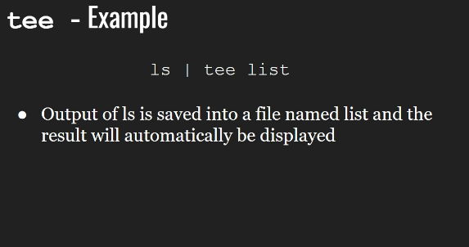

Slide 11
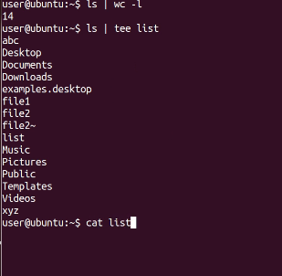

Slide 12
tar command in Linux
The Linux ‘tar’ stands for tape archive, is used to create Archive and extract the Archive files. tar command in Linux is one of the important command which provides archiving functionality in Linux. We can use Linux tar command to create compressed or uncompressed Archive files and also maintain and modify them.

Slide 13
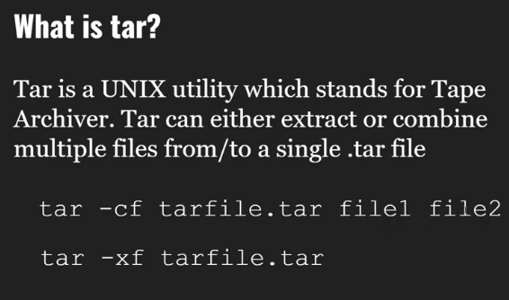

Slide 14
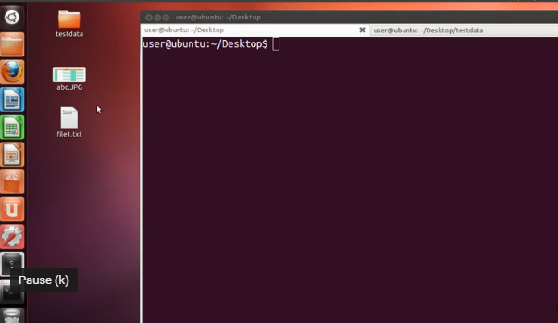

Slide 15
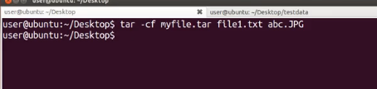
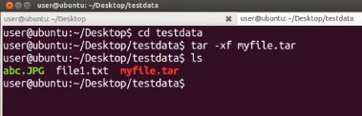

Slide 16
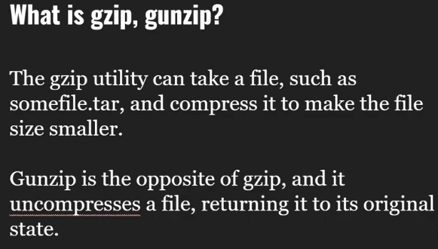

Slide 17
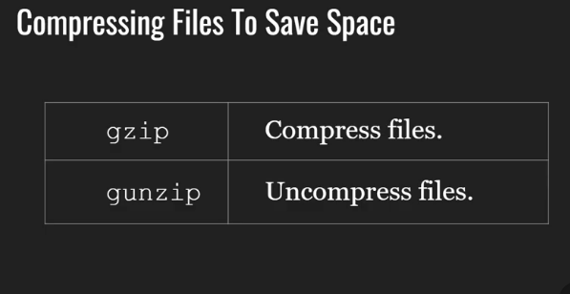

Slide 18
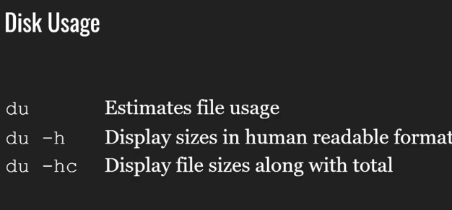

Slide 19
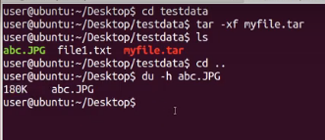
du –h <file name>

Slide 20
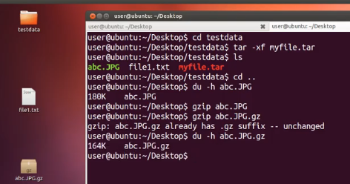
$gzip <File name>
For unzip
$gunzip <Filename>
$gunzip abc.JPG.gz

Slide 21
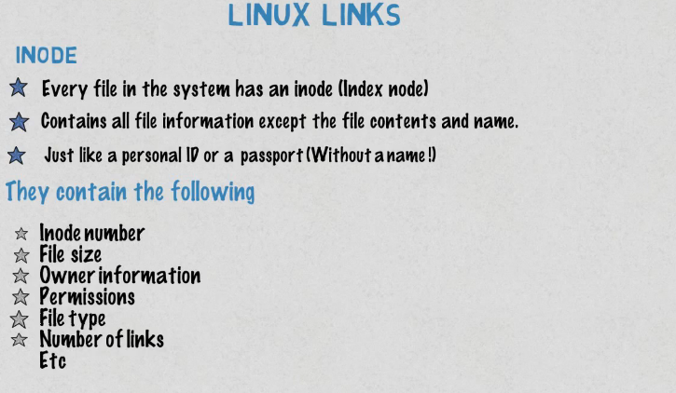

Slide 22
Linux File Links
A Linux filesystem has many hard links and symbolic links. A link is a connectivity between the filename and the actual data byte in the disk space. More than one filename can link to the same data.
There are two types of links in Linux OS:
Soft Links
Hard Links

Slide 23
1) Soft Links (Symbolic Links)
Soft links are very common. It represents a virtual or abstract location of the file. It is just like the shortcuts created in Windows. A soft link doesn't contain any information or content of the linked file, instead it has a pointer to the location of the linked file. In other words, a new file is created with new Inode, having a pointer to the Inode location of the original file.
It is used to create link between directories and can cross filesystem boundaries. When the source file is removed or moved, then soft links are not updated

Slide 24
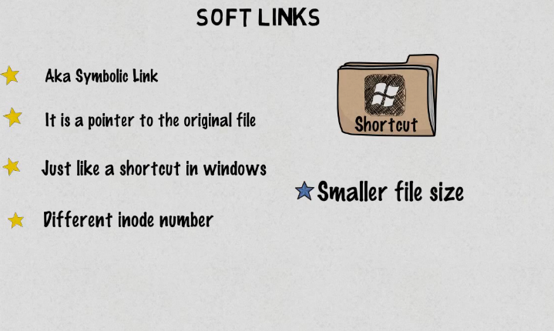

Slide 25
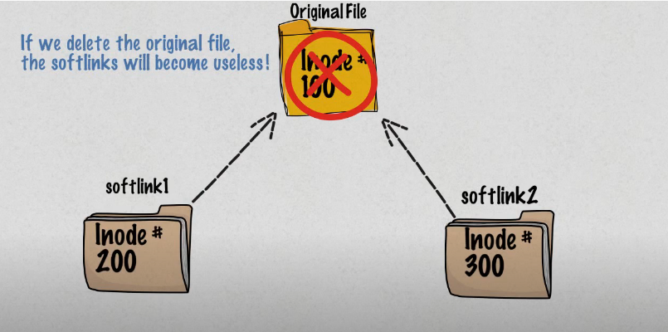

Slide 26
2) Hard Links
They are the low-level links. It links more than one filename with the same Inode and it represents the physical location of a file.
When hard link is created for a file, it directly points to the Inode of the original file in the disk space, which means no new Inode is created. Directories are not created using hard links and they can not cross filesystem boundaries. When the source file is removed or moved, then hard links are not affected.

Slide 27
